Slide 1

Governor’s Workforce Development Board
DECEMBER 12, 2018
Opioid Operational Command Center
Speaker:
Birch Barron
Deputy Director
Maryland Opioid Operational Command Center
birch.barron@maryland.gov

Slide 2





Nearly 6 deaths every day in Maryland
130+ deaths per day in the United States
Notes:
I would like to have 6 people raise their hands. Look around at those people with their hands raised.
~6 deaths/day in Maryland
142 Americans dying every day. America is enduring a death toll equal to September 11th (nearly 3,000 deaths)
every three weeks.

Slide 3
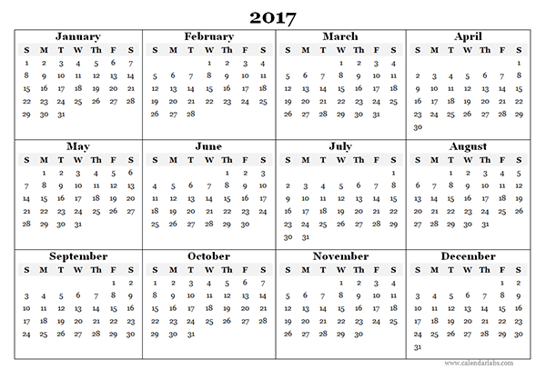


Notes:
Imagine you start out the year with a 9/11-level event. Nearly 3,000 dead. Then in early February, another event. Then another.

Slide 4
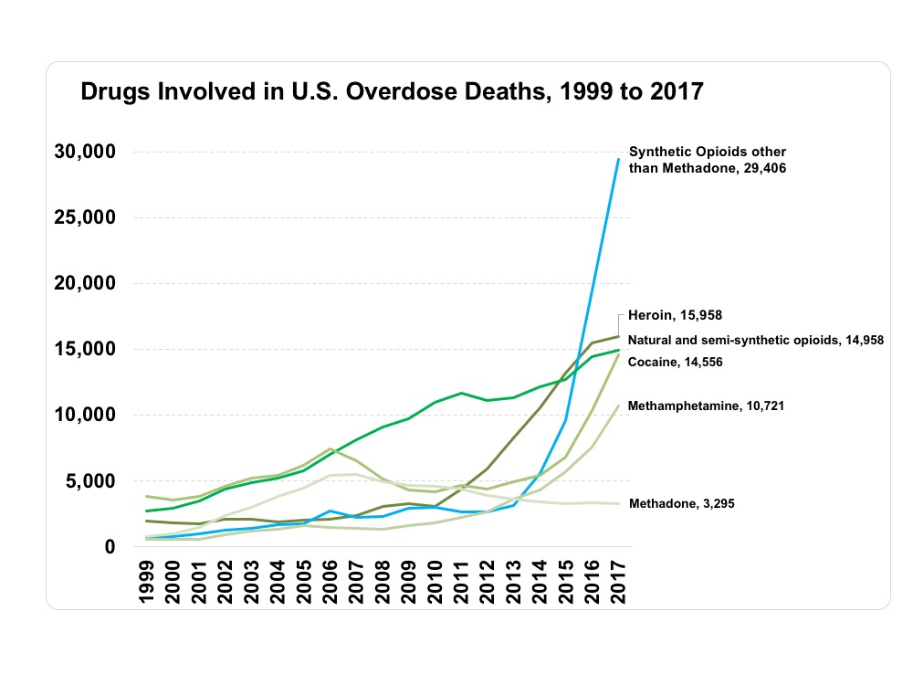
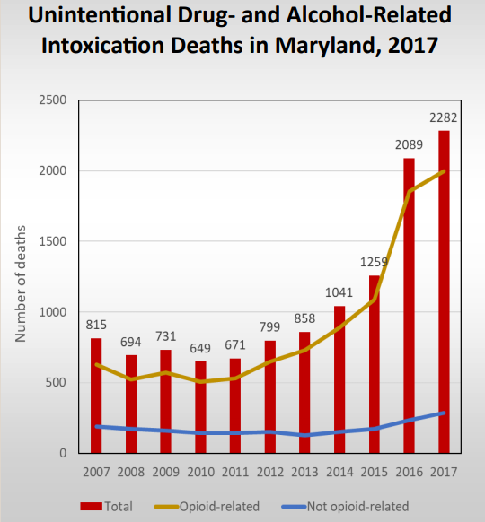
Drug- and Alcohol-Related Intoxication Deaths, U.S. and Maryland
NIDA - https://www.drugabuse.gov/related-topics/trends-statistics/overdose-death-rates
Maryland Dept. of Health - https://bha.health.maryland.gov/OVERDOSE_PREVENTION/Documents/Drug_Intox_Report_2017.pdf

Slide 5
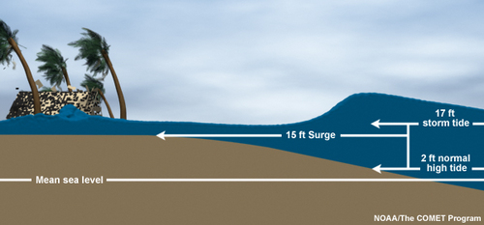
What is Causing this increase?
FENTANYL
HYDROCODONE (LORCET, VICODIN)
HEROIN
OXYMORPHONE (DILAUDID)
OXYCODONE
(OXYCONTIN, PERCOSET)
MEPEREDINE
(DEMEROL)
CODEINE
MORPHINE
Notes:
You have the storm surge, which raises the sea level and creates all of the right conditions for disaster.
Then the tide comes in, and rather than crash harmlessly on the beach, that wave comes right up on top of the surge and just devastates.
With the opioid crisis, you have this slow-building storm surge throughout the 90s & early-2000s, where supposedly “safe” medical opioids are being prescribed like candy, steadily increasing the percentage of our population that is chemically dependent on these drugs.
When their prescriptions run out, these people start to feel sick, and look to extend their prescriptions in any way they can.
Sooner or later, many of them realize that it is cheaper and easier to buy heroin than to find prescription drugs (nearly 80% of heroin users reported using prescription drugs prior to turning to heroin, and over 40% of those users began with a legally-prescribed opiate).
So you have this perfect storm, where a steadily-increasing percentage of the population is chemically dependent on opioids (*click animation for drug names)
Then, around 2013, you see this guy show up (*click animation for FENTANYL*). You already have the storm surge, non-pharmaceutical fentanyl is your tidal wave.

Slide 6
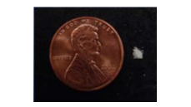
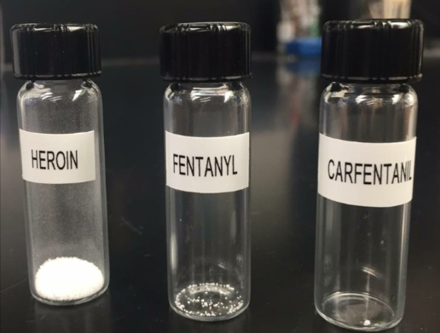
Non-Pharmaceutical Fentanyl
Fatal Dose
(varies widely by user and the method of consumption)
Heroin Fentanyl Carfentanil
30 mg 2-3mg 200 micrograms
2mg of powder shown next
to a penny (DEA)
Notes:
While a fatal dose varies widely by user and the method of consumption,
30 mg of heroin, or
2-3 mg of Fentanyl can be fatal.
Theoretically, a fatal dose of Carfentanil could be as little as 200 micrograms

Slide 7
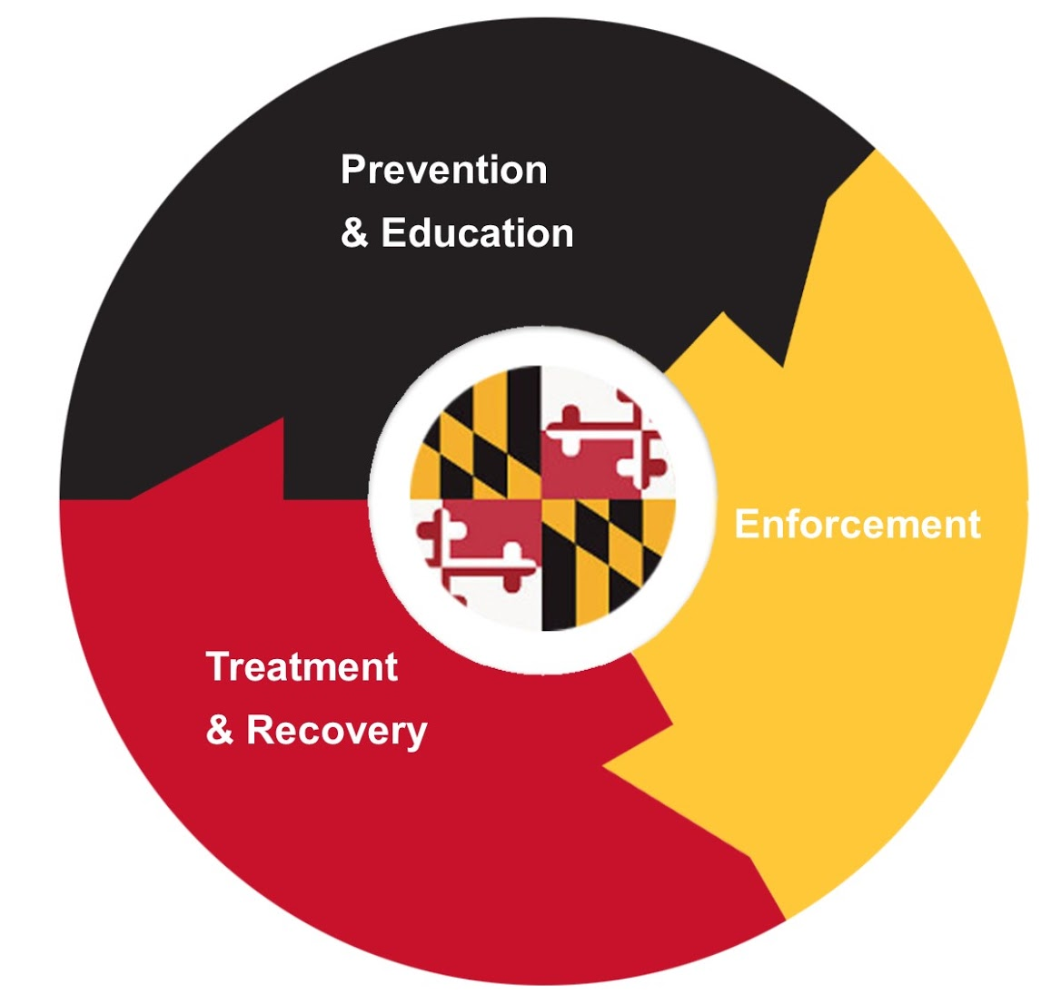
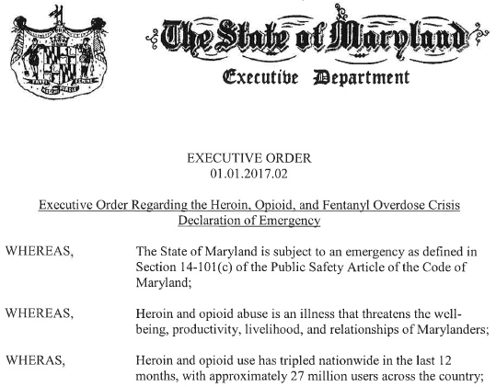
Maryland’s Declaration of Emergency
Notes:
Empowers the OOCC to:
Drive priorities across State agencies
Engage communities to form local jurisdiction coordination bodies (Opioid Intervention Teams)
Delegate emergency powers to state and local emergency management officials
Oversee a supplemental budget of $50 million in new funding over a five-year period

Slide 8
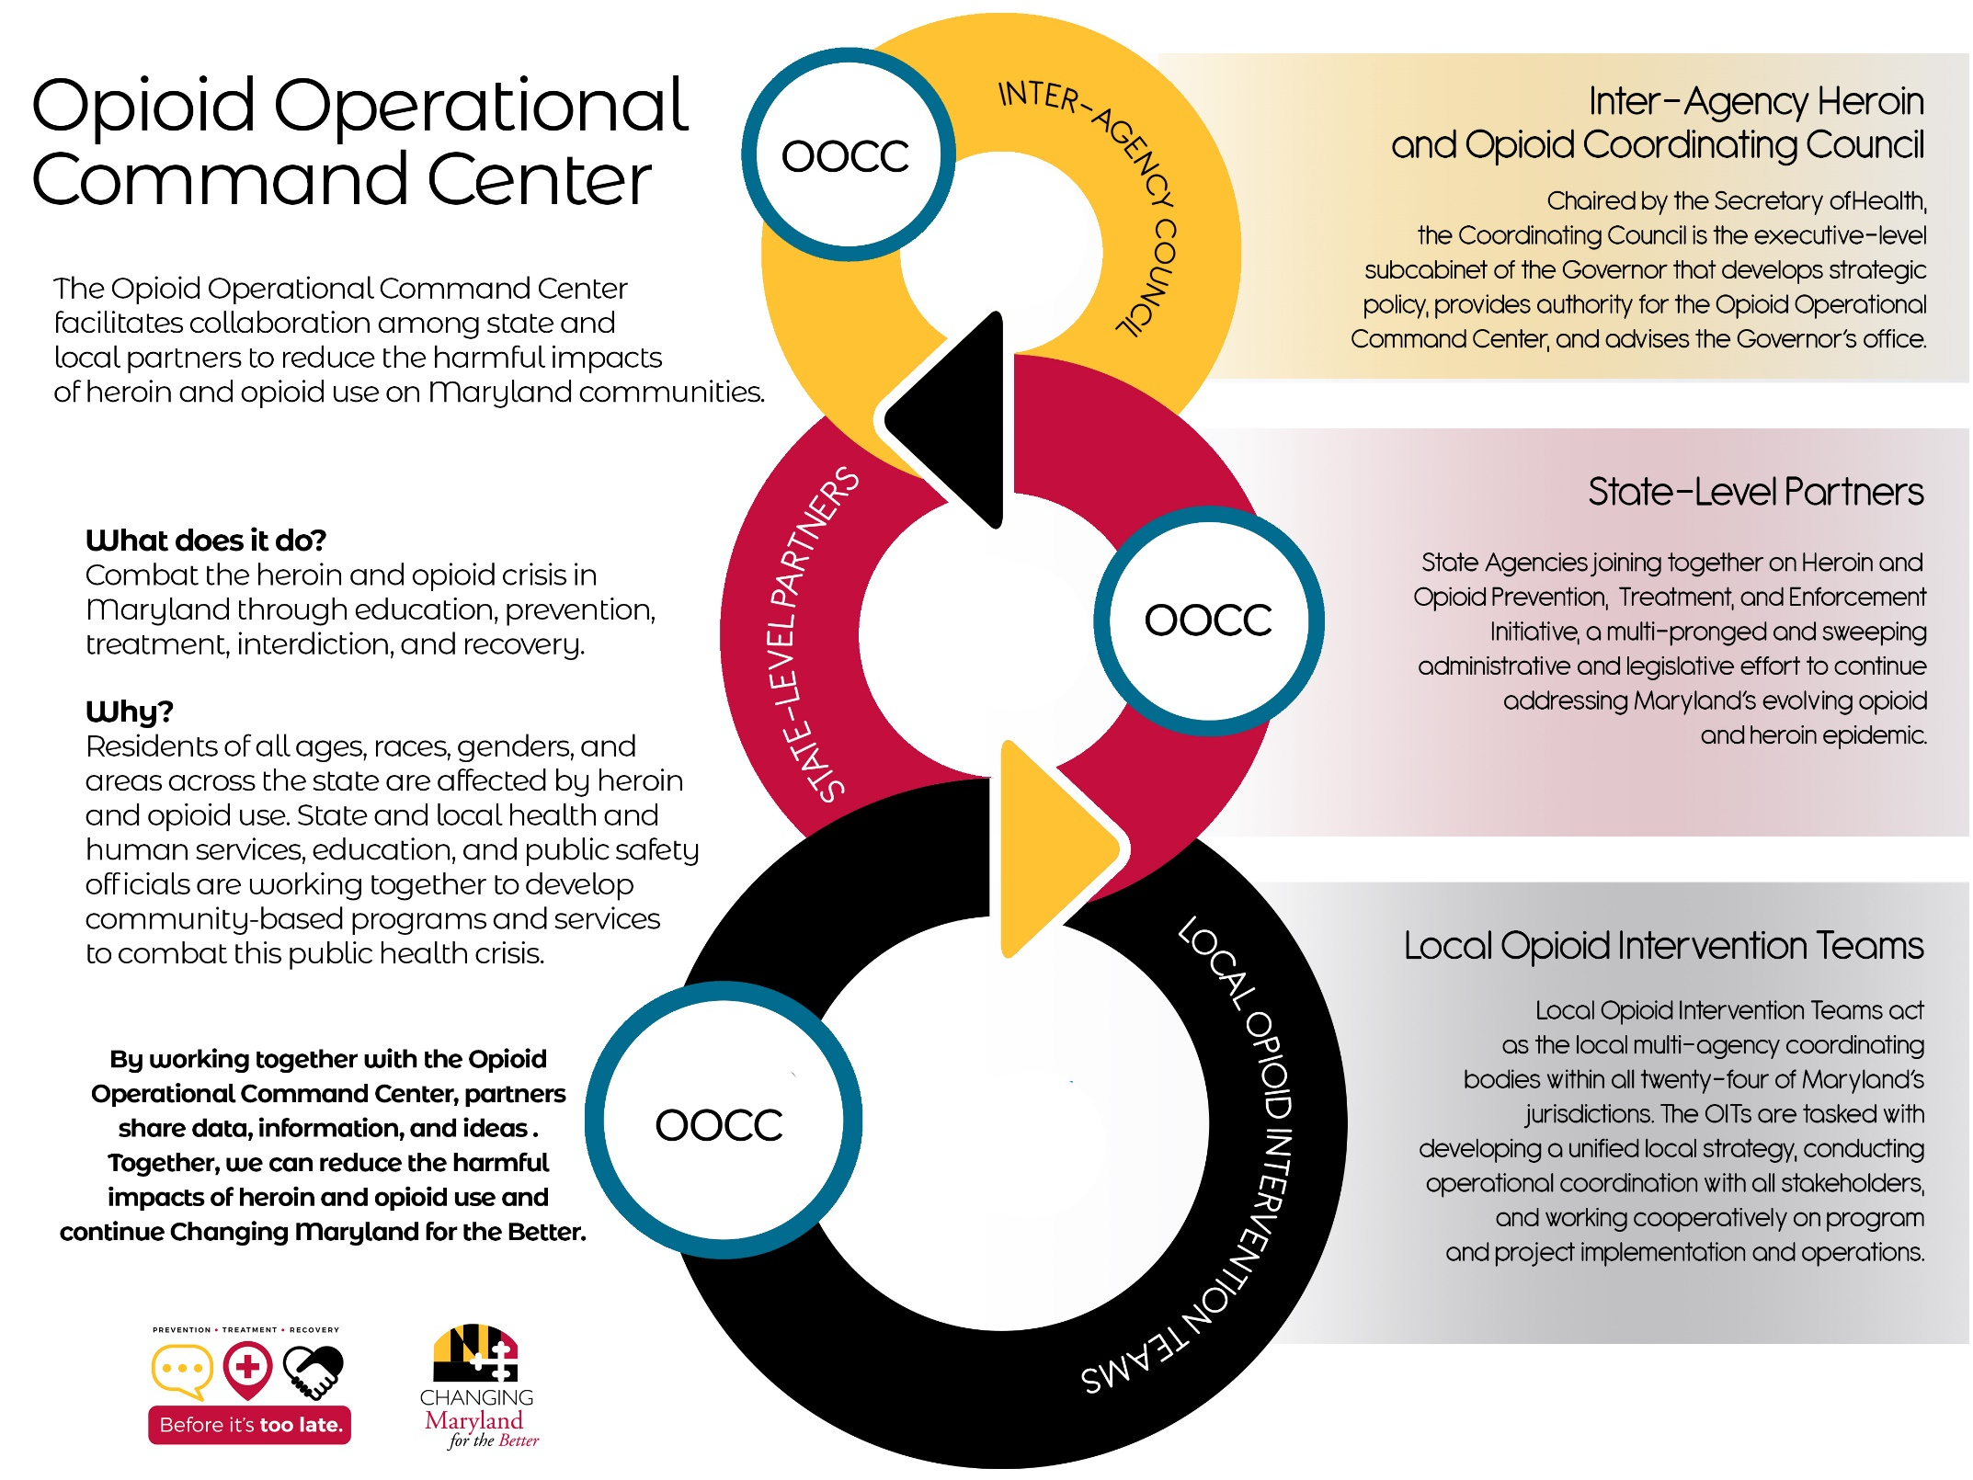
Notes:
Clay
Per executive order, the Opioid Operational Command Center (OOCC) is authorized to
Direct the state agency response
Coordinate among the Inter-Agency Council, state agencies, local jurisdictions, and community-based organizations
Facilitate collaboration
Enhance data collection

Slide 9
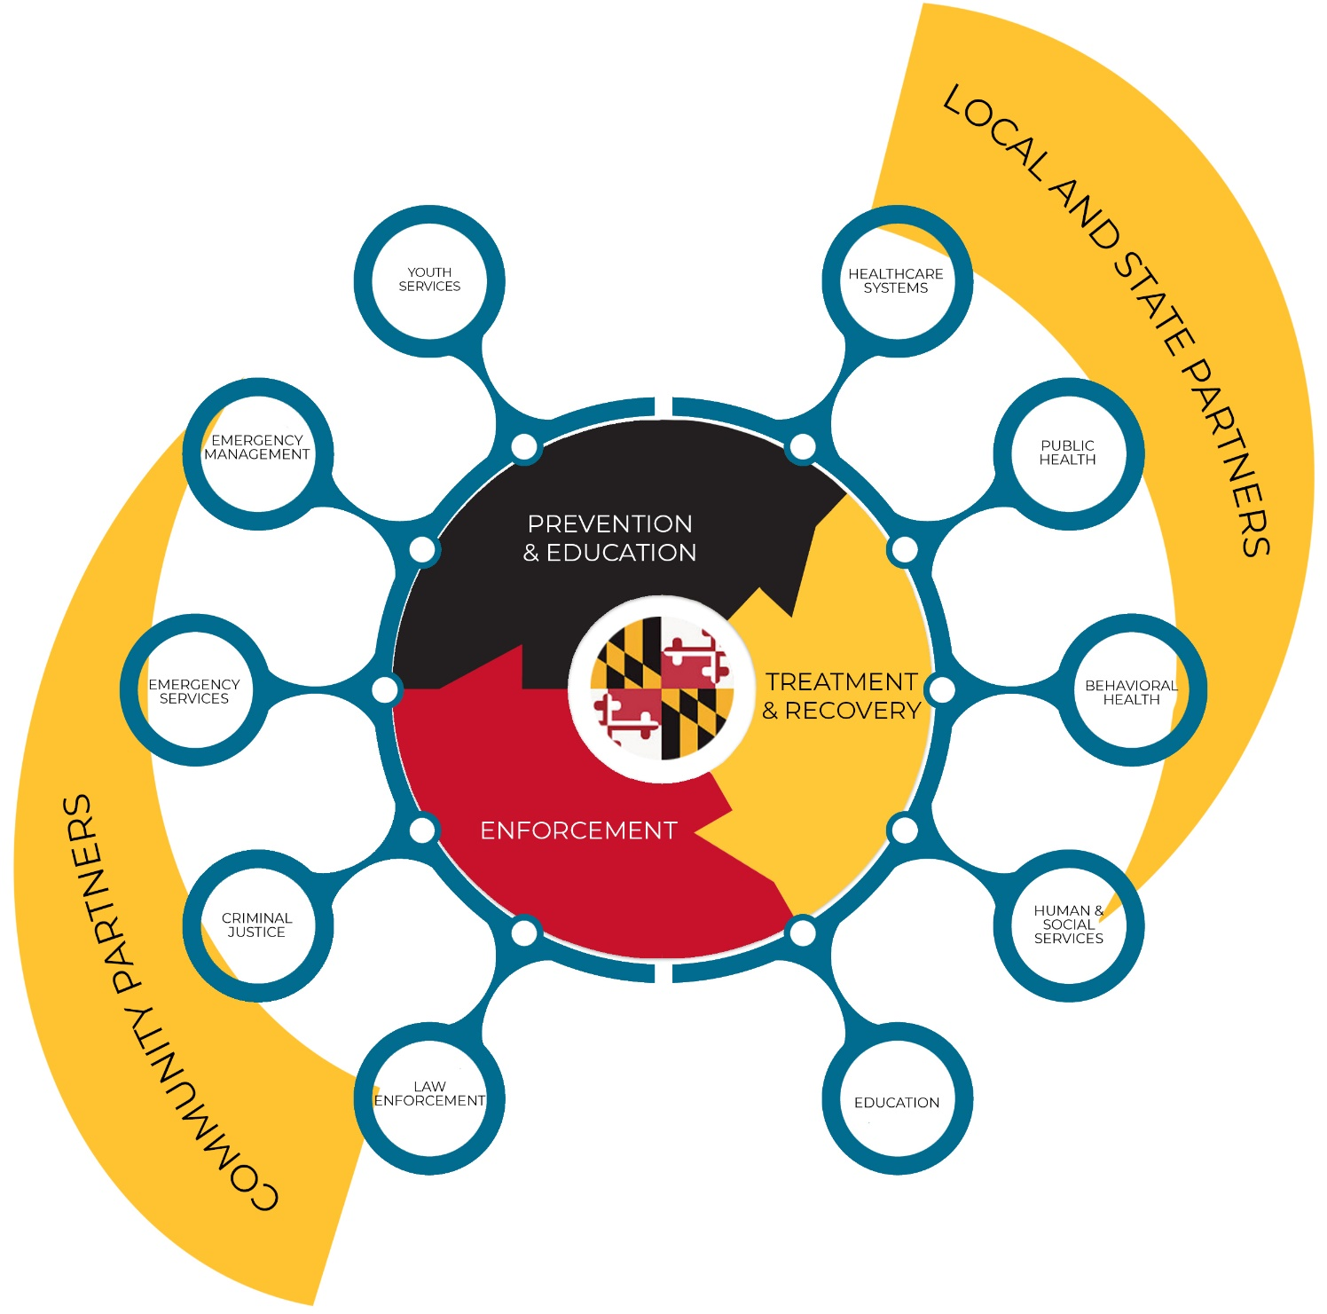
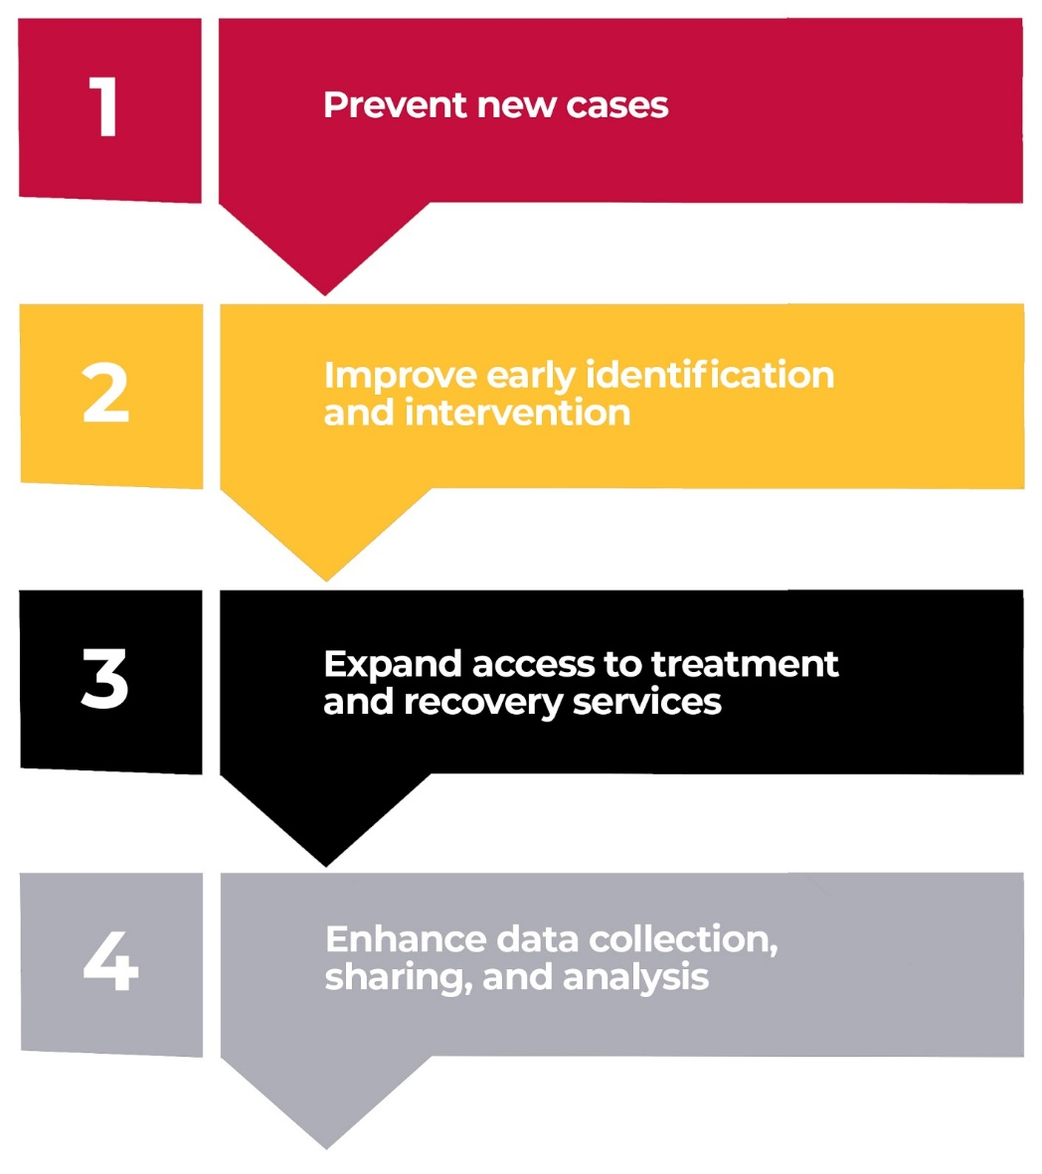

Slide 10
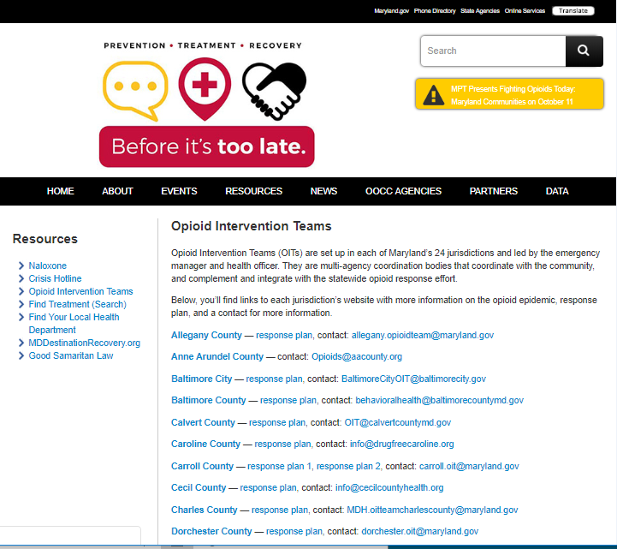
Local Opioid Intervention Team Response
Local Opioid Resource Website
Community Response Plan
OIT Leadership Contact Information
http://beforeitstoolate.maryland.gov/opioid-intervention-teams

Slide 11
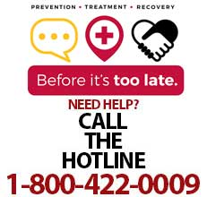
Workforce Development as a Part of the Solution
Employment is Critical to Recovery
New Occupational Sectors and Environments
Crisis support, peers/care coordinators, recovery coaches
Addressing Misconceptions and Stigma
Recovery, treatment/relapse expectations, MAT, drug testing
Protecting your employees and coworkers
Ensure that everyone you care about understands the risks of opioid use and the resources available if they need help
2-1-1
press 1

Slide 12

Questions?
Web: BeforeItsTooLateMD.org
Local Resources: http://beforeitstoolate.maryland.gov/opioid-intervention-teams
Facebook: facebook.com/BeforeItsTooLateMD
Twitter: @BeforeIts2Late

Slide 13
Governor’s Workforce Development Board
DECEMBER 12, 2018
Speaker:
Erin Roth
Acting Deputy Assistant Secretary
Division of Workforce Development and Adult Learning
Maryland Department of Labor, Licensing and Regulation

Slide 14
Workforce Development as a Part of the Solution
Notes:
DLLR, the OOCC and the BHA have come together to develop innovative workforce development solutions that integrate critically important behavioral health services with the resources of the workforce system to drive meaningful change for this complex issue.

Slide 15
Workforce Development as a Part of the Solution
DLLR secured two federal grants
  $1.9M from USDOL - Employment and Training Administration
  $650K from USDOL - Women’s Bureau

Slide 16
Workforce Development as a Part of the Solution
USDOL – ETA ($1.9M) | USDOL – Women’s Bureau ($650k)
Resources for American Job Centers Anne Arundel Baltimore City Baltimore County Frederick Mid Maryland Susquehanna Upper Shore Western Maryland Opioid Workforce Innovation Fund Smaller Grant Awards | Pilot Pre-Apprenticeship at Maryland Correctional Institute for Women Opioid Workforce Innovation Fund – Women RFP process Larger Awards

Slide 17
QUESTIONS?

