Slide 1
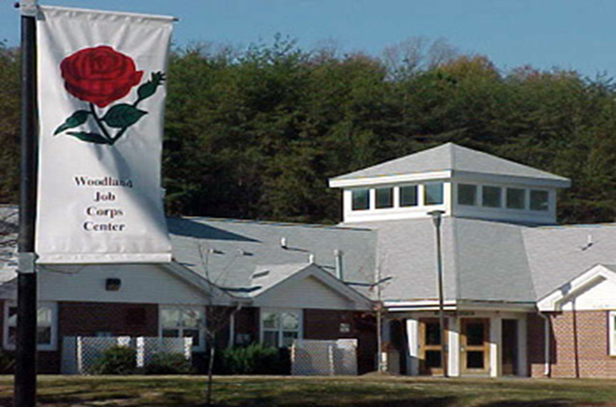
Woodland Job Corps Center Overview
Woodland Job Corps Center 3300 Fort Mead Road Laurel, MD 20724
Center Director
Norman B. Turner
Home of the Warriors

Slide 2
Woodland Job Corps Center: Student Overview
300 student On Board Strength.
Demographics
African American: 80.82%
White: 6.53%
Hispanic: 6.12%
Students primarily from Maryland and the District of Columbia
64.2% entered without a High School Diploma or High School Equivalency
The majority of students arrive with less than an 8th grade educational level.
Reading and Math levels upon enrollment are displayed below.

Slide 3

Woodland Education & Training
Academics
Basic Reading
Basic Math
ELL/ESL
Driver’s License Training
HSD/HSE Options
GED
Penn Foster
CTT Offerings
Hospitality: Advanced Culinary (Anne Arundel Community College), Culinary, Hotel & Lodging
Construction: Electrical (IEC), Facility Maintenance (HBI), Carpentry (HBI)
National Offerings- Career Technical Training (CTT): 67 Career Technical Trades in 11 Career Pathways
(Advanced Manufacturing, Automotive & Machine Repair, Construction, Finance & Business, Health Care, Hospitality, Information Technology, Renewal Resources & Energy, Retail Sales & Service and Transportation)

Slide 4

Beyond Education and Training
Advantages of a Residential Program
Structured Programming
Training in a healthy, safe living environment
Career Success Skills Training
Extended Training Day programming
Wellness Services
Recreational Programming
Dorm Life
Personal & Career Counseling
QUALITY CASE MANAGEMENT
Job Corps is the federal government’s only residential job training program!

Slide 5

Job Placement
Primary focus is positive placements after center program completion
Job Placement with full time employment with a livable wage
Enrollment in College
Advanced Training
Military Enlistments
Apprenticeship programs
Placement Support throughout enrollment
Career Preparation Period (30-45 day Orientation Period):
Students explore career training options
Conduct LMI analysis
Career Plan Development
Career Development Period (CDP):
Academics (HSE/HSD)
Career Technical Training tied to Industry Certifications
Life Skills Development
Job Readiness (Work Based Learning, Job Search Skills)
Career Transition Period (CTP) Post Separation:
Placement and Transitional Support Services
2nd & 4th Quarter follow-up after completion of the program.

Slide 6

Performance Measures
Outcome Measurement System (OMS)
Monthly Rating and Ranking of all Job Corps Centers, Outreach and Admissions (Recruitment) and Career Transition Services (Placement) contracts
Performance Categories consistent with WIA/WIOA and Common Measures
Criteria identified on an annual basis, with national, and center-specific (wage, HSE/HSD) goals set

Slide 7

Current Center OMS Measures
HSD/HSE Attainment
CTT Completion
Credential Attainment
Combination of both HSE/HSD and CTT Completion
Literacy Gains
Numeracy Gains
Job Training Match
Former Enrollee initial placement
Graduate Placement
Graduate Wage
Graduate Full-time Job
2nd Quarter Placement of Graduate
2nd Quarter wage of graduate
4th Quarter Placement of graduate
4th Quarter wage of graduate

Slide 8


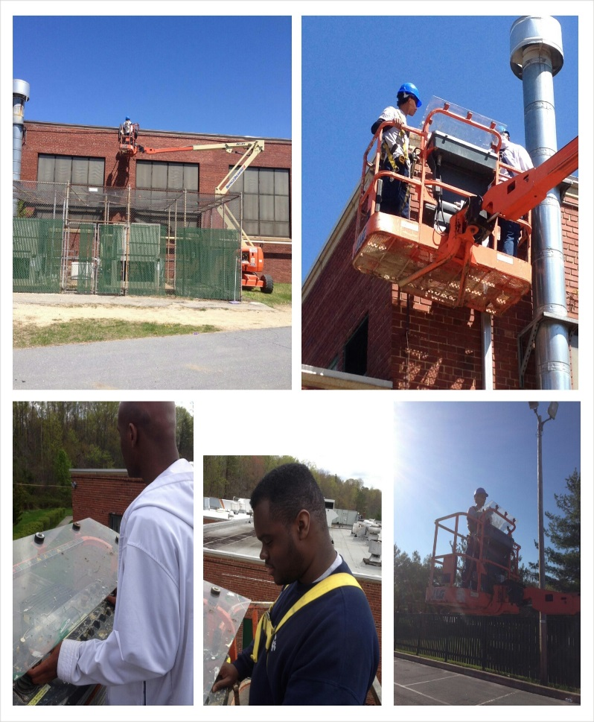
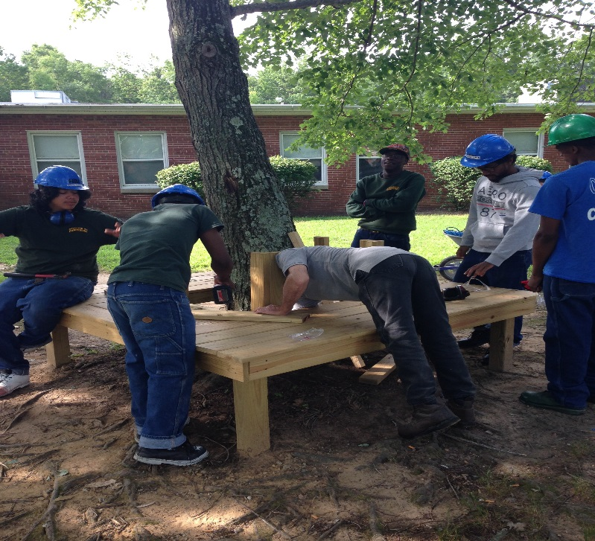

Woodland Job Corps Center Prepares Students for Success!

