Slide 1
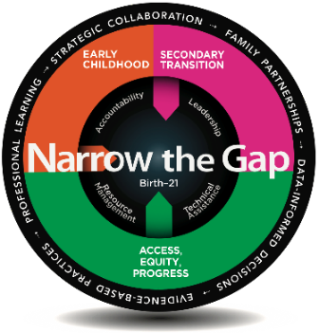


Maryland Certificate of Program Completion
MOVING MARYLAND FORWARD SHARPEN THE FOCUS FOR 2020
JUNE 2021
PRESENTATION TO THE GOVERNOR’S WORKFORCE DEVELOPMENT BOARD
Marcella E. Franczkowski, Assistant State Superintendent
DIVISION OF EARLY INTERVENTION & SPECIAL EDUCATION SERVICES
© 2021 Maryland State Department of Education | Division of Early Intervention and Special Education Services, Marcella E. Franczkowski, Assistant State Superintendent | 06/9/2021

Slide 2
“Your first day of adulthood should be no different than your last day of high school.”
© 2021 Maryland State Department of Education | Division of Early Intervention and Special Education Services, Marcella E. Franczkowski, Assistant State Superintendent | 06/9/2021

Slide 3
In Maryland…
6,714 Students with Disabilities Exit High School
31.9%
68.5%
61.9%
Decrease in dropout rate for students with disabilities over the past five years
Graduation rate, which results in a 5% gap reduction for students with disabilities compared to students without disabilities in the past five years
Students with Disabilities are enrolled in postsecondary education and/or employed 1 year after exiting high school
Data Source: FFY 2019 State Performance Plan/Annual Performance Report
© 2021 Maryland State Department of Education | Division of Early Intervention and Special Education Services, Marcella E. Franczkowski, Assistant State Superintendent | 06/9/2021

Slide 4
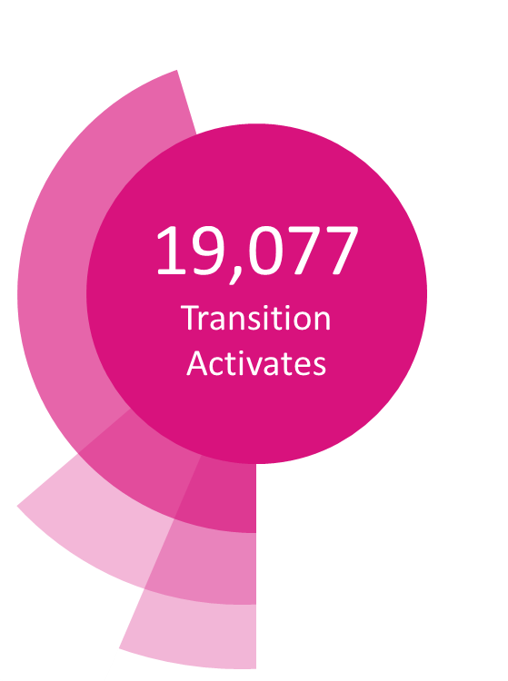
We Continue to Provide Opportunities…
19,077
Employment Training
Transition Activities
“The most compelling predictor of post-school success is paid work experiences.”
45% Career Exploration
10% Unpaid Work
5% Paid Work
Data Source: Maryland Online IEP System
© 2021 Maryland State Department of Education | Division of Early Intervention and Special Education Services, Marcella E. Franczkowski, Assistant State Superintendent | 06/9/2021

Slide 5
Maryland Exit Pathways
High School
Diploma
Certificate of
Program Completion
© 2021 Maryland State Department of Education | Division of Early Intervention and Special Education Services, Marcella E. Franczkowski, Assistant State Superintendent | 06/9/2021

Slide 6
Preparation begins before exiting high school…
Division of Early Intervention and Special Education Services (DEI/SES) Strategic Plan for students with disabilities, including preparation for students ages 14-21
Endorsement areas for Maryland Certificate of Program Completion
  Parallel expectations to mirror the endorsements on the Maryland High School Diploma
© 2021 Maryland State Department of Education | Division of Early Intervention and Special Education Services, Marcella E. Franczkowski, Assistant State Superintendent | 06/9/2021

Slide 7
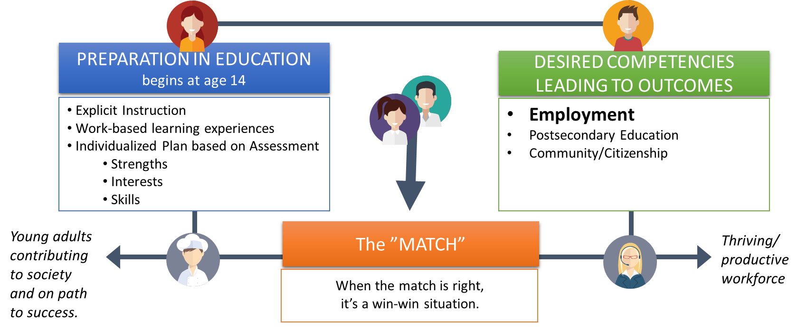
Maryland Sees the Value in Preparation
In partnership with businesses, we are seeking to maximize the talents and skills of our future workers to match the needs and demands of the workforce.
© 2021 Maryland State Department of Education | Division of Early Intervention and Special Education Services, Marcella E. Franczkowski, Assistant State Superintendent | 06/9/2021

Slide 8



Preparation Leads to Certificate of Program Completion Endorsements
Work-Ready/Employment/Career; and/or
Post-Secondary Education; and/or
Community/Citizenship.
© 2021 Maryland State Department of Education | Division of Early Intervention and Special Education Services, Marcella E. Franczkowski, Assistant State Superintendent | 06/9/2021
Notes:
"On May 25, 2021 The State Board adopted changes in language to COMAR to add these three Endorsements to the Maryland Certificate of Program Completion.
Maryland stakeholders from diverse backgrounds collaborated to Identify three main themes for endorsement areas:
Pursuing competitive, integrated employment, career pathways, and exhibiting work-readiness,
Pursuing post-secondary education, and
Experiencing enhanced engagement and increased independence in the community
Maryland is currently in the planning phase of creating meaningful enhancements to these three areas for endorsements to the MD Certificate of Program Completion. The Class of 2025 will be our first group to work towards additional enhancements to the Certificate of Program Completion under the three endorsement areas. We will be convening in the coming weeks to address Critical Competencies, observable skills, and the criteria for mastery under the three endorsement areas.

Slide 9
A Unique Opportunity to Develop the Future…Together!
© 2021 Maryland State Department of Education | Division of Early Intervention and Special Education Services, Marcella E. Franczkowski, Assistant State Superintendent | 06/9/2021

Slide 10
What are the needs to create greater meaning to the Certificate of Program Completion?
Your experience and knowledge
3-5 business leaders to participate in 2-3 meetings with a diverse group of stakeholders
Ideas and options for a work readiness endorsement
© 2021 Maryland State Department of Education | Division of Early Intervention and Special Education Services, Marcella E. Franczkowski, Assistant State Superintendent | 06/9/2021

Slide 11
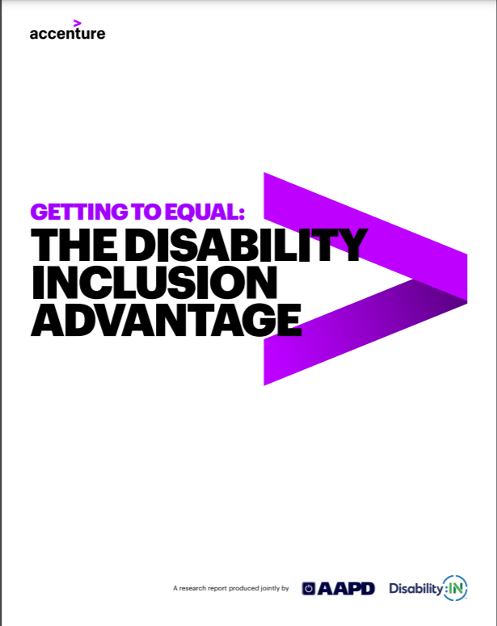
Higher Revenues (up 28%)
Net Income (up 200%)
Profit Margins (up 30%)
© 2021 Maryland State Department of Education | Division of Early Intervention and Special Education Services, Marcella E. Franczkowski, Assistant State Superintendent | 06/9/2021

Slide 12
For more information or to get involved in this important work, please contact:
Marcella E. Franczkowski: Marcella.Franczkowski@maryland,gov
© 2021 Maryland State Department of Education | Division of Early Intervention and Special Education Services, Marcella E. Franczkowski, Assistant State Superintendent | 06/9/2021

Slide 13
“Every disability conceals a vocation, if only we can find it, which will ‘turn the necessity to glorious gain.”
– C.S. Lewis
© 2021 Maryland State Department of Education | Division of Early Intervention and Special Education Services, Marcella E. Franczkowski, Assistant State Superintendent | 06/9/2021

